Slide 1
NLP Module-3
Machine Translation

Slide 2
Outline
Introduction
History of Machine Translation
Existing Machine Translation System
Approaches to MT
Translation Unit

Slide 3
Introduction to Machine Translation

Slide 4
Translation?
The process of transforming natural language text from one language (source language) into a meaningfully equivalent text in the second language (target language) is called translation.
  Ref: [M.A Khan (1995)]
Source text ----------------> Target text
Source language
Target language
Translation by human being

Slide 5
Translation…
Note:
  The closeness of the target text into the source text is an idealism which is not always achievable.
  The closer the meaning of the two text to each other, the more accurate will be the translation and the higher will be the quality of translation.

Slide 6
Human translator
A person who is responsible for the translation of one natural language text (or speech) to another natural language text (or speech) is called human translator
Also called technical translator

Slide 7
Types of human translator
Language specialist:
  A specialist of some field, e.g. engineering etc., but also having specialties in one or several foreign languages
Linguists:
  Know more than one languages from the very beginning
  A specialist of several languages.
Trained person:
  Get education of more than one languages in some educational institute

Slide 8
Problems with a human translator
Shortage memory
Can get tried and bored
Expensive/Charge fee
Not available everywhere
Can die
Translate same word/sentence differently in different times

Slide 9
Need of a machine translation system
To overcome the limitations of human translators, we need machine translation systems

Slide 10
Machine translation…
Definition 1:
  Machine Translation (MT) is the task of automatically converting one natural language into another, preserving the meaning of the input text, and producing fluent text in the output language.
Source text ----------------> Target text
Source language
Translation by machine
Target language

Slide 11
Machine translation….
Definition 2:
  The application of computers to the translation of texts from one natural language to another.
    Ref: [Hutchins (1986)]

Slide 12
History of MT

Slide 13
1) GETA
GETA was an machine translation project.(Groupe d’Etudes pour la Traduction Automatique)
Group study for automatic translation”.
Initial name was CITA (Corpus Italiano di Apprendenti )
It was developed in 1959 at CNRS(Centre national de la recherche scientifique) France.
Initial objective of this was to translate the space messages of Russian into French.
Transfer approach and MT methodology
Other researchers that worked at some point in GETA experimented with English-Malay and English-Thai translations.

Slide 14
GETA (Cont..)
The translation process in GETA consist of three main stages
Analysis
Transfer
Generation

Slide 15
2) EUROTRA
Initiated in 1978 by European Community R&D program in MT
The EUROTRA project is the machine translation program of the European Community
The objective of this project is the creation of a small multilingual (using many language) system.

Slide 16
EUROTRA (Cont...)
Serve as a basis for industrial development.
It also consist of three main phases i.e.
  Analysis
  Transfer and
  Generation

Slide 17
3) DLT
Distributed language translation
Is a Dutch MT system
It was initiated by a Dutch engineer Toon Witkam in 1979
Consist of two main phases i.e.
  Analysis and
  Generation

Slide 18
DLT (Cont...)
This system use interlingua language (international language; based on words common to English ) approach
Translate text from English into French

Slide 19
4) SUSY
This MT system was developed in the University of Saar (West Germany)
Based on the principles of multilinguality (more than one languages)
Initially work began on Russian and German languages

Slide 20
SUSY (Cont...)
The system consist of three major components
  Analysis
  Transfer and
  Generation
Nowadays, SUSY is called STS (Semantic Textual Similarity )
Use for computer-aided translation(CAT)
CAT is a form of language translation in which a human translator uses computer hardware to support and facilitate the translation process.

Slide 21
5) SYSTRAN
Developed in 1960,s by Peter Toma
Translate English into French and Italian
It was first used by U.S. Air Force
1988 it was working for 12 languages

Slide 22
SYSTRAN (Cont...)
This system is “hybrid ‘direct transfer’ system”

Slide 23
6) BABEL-Research
It is a group of researchers in the University of Brussels, Belgium
This research is still in its infancy (early stage)
Funded by an organization UNISYS (Unisys is an American global information technology company)

Slide 24
BABEL-Research (Cont...)
The languages involve are English, French, Dutch and German
Transfer architecture is used.
The programming language use in BABEL-Research is Pascal.

Slide 25
Conclusion
All these systems are sentence based which reflects or show the current state-of-art in MT.

Slide 26
Reference
M. A. Khan, Text Based Machine Translation, 1995

Slide 27
History of machine translation....
Examples of online translation systems
  SYSTRAN
    http://www.systranet.com/translate
  Google translate
    http://www.translate.google.com
  AltaVista's Babelfish
    http://babelfish.yahoo.com/
  Microsoft translator
    http://www.microsofttranslator.com/

Slide 28
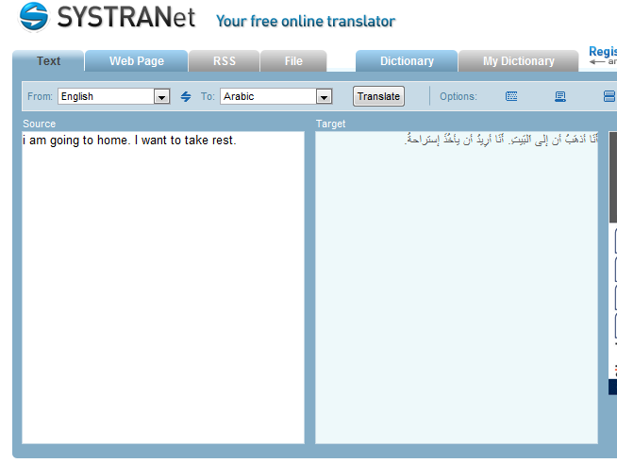
SYSTRAN system
http://www.systranet.com/translate

Slide 29
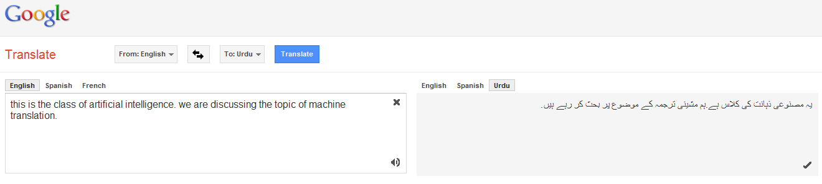
Google translate system
https://translate.google.com.pk/

Slide 30
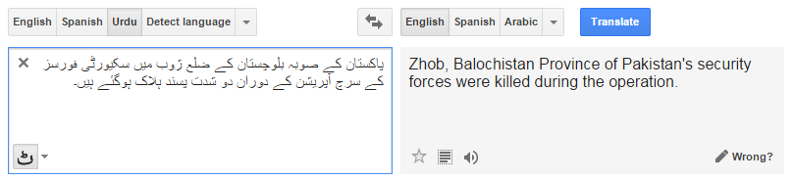
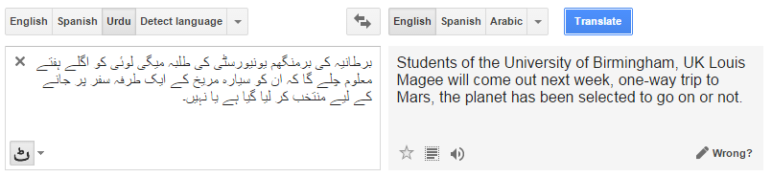
Example

Slide 31
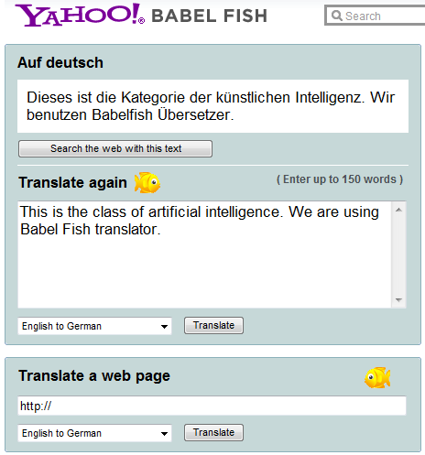
Yahoo Babel Fish system

Slide 32
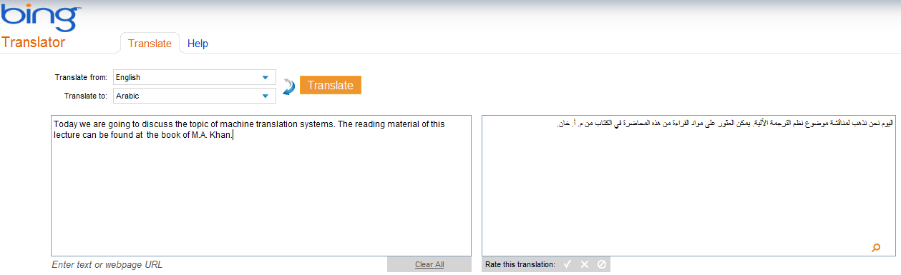
Microsoft translator

Slide 33
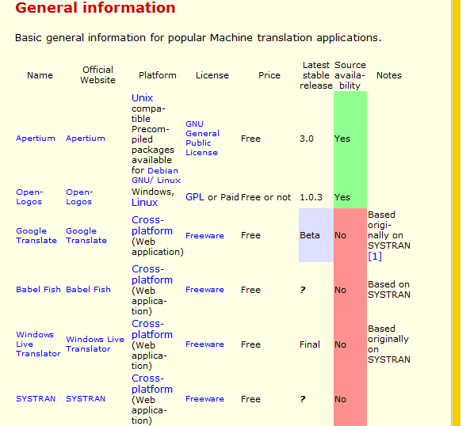
Other online machine translation systems

Slide 34
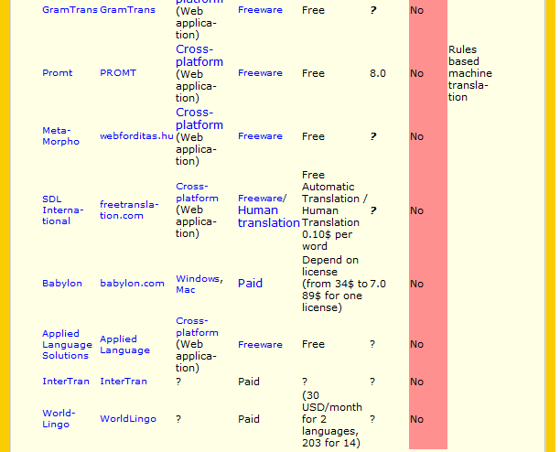
Machine Translation (MT) by Rahman Ali, Lect: QACC, UOP

Slide 35
Importance of machine translation
Provides Cheap, universal access to world’s online information regardless of original language.
Used in education, politics, business, trade, cultural study and media.
A combination of text+speech translation enables:
  Two persons, that do not know each other language, to talk to each other on the telephone
  Participants in a conferences, debates and discussion forum in international organization such as UNO, ECO etc to talk to each other.
  The translation of films in film industry to other languages
To translate a spoken in to the written language or signed language of deaf people

Slide 36
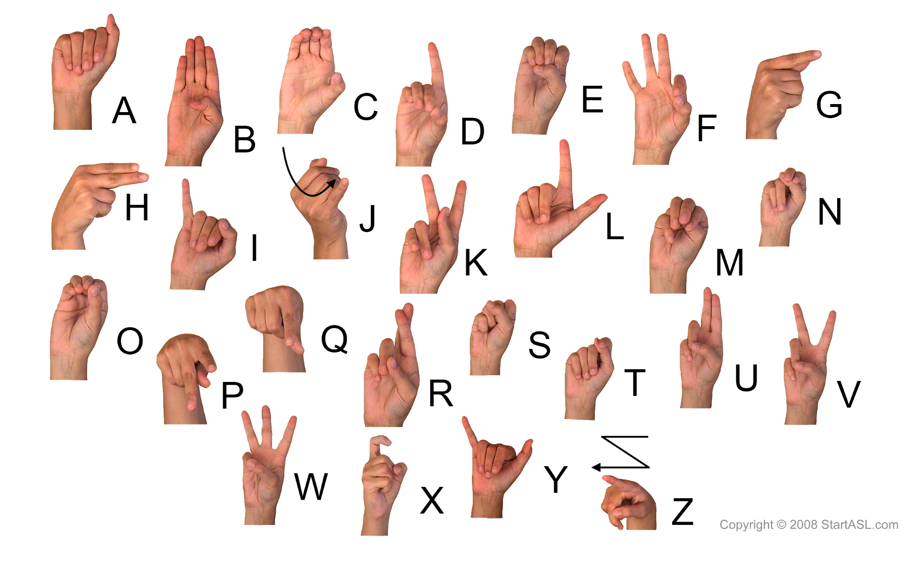
Signed language:

Slide 37
Types of Machine Translation

Slide 38
Types of machine translation
Monolingual
Bilingual
Multilingual

Slide 39
Monolingual machine translation
The translation of natural language text of the source language to the target text in the same language is called Monolingual Machine Translation.
Source Text (English)……..Computer…………> Target Text (English)
Source Text (Urdu)……..Computer…………> Target Text (Urdu)
Source Text (Pashto)……..Computer…………> Target Text (Pashto)

Slide 40
Bilingual machine translation
The translation of natural language text written in one natural language to the target text in the other language is called bilingual Machine Translation.
Source Text (English)……..Computer…………> Target Text (Pashto)
Source Text (Urdu)……..Computer…………> Target Text (Chines)
Source Text (Pashto)……..Computer…………> Target Text (Hindko)

Slide 41
Multilingual machine translation
The translation of natural language text written in one language to the target text in more than two languages is called Multilingual Machine Translation.
Source Text (English)……..Computer…………> Target Text (Urdu, Pashto)
Source Text (Urdu)……..Computer…………> Target Text (Hindko, Japanies, Turkish)

Slide 42
References
[1] W. Weaver (1955). Translation (1949). In: Machine Translation of Languages, MIT Press, Cambridge, MA.
[2] P. Brown, S. Della Pietra, V. Della Pietra, and R. Mercer (1993). The mathematics of statistical machine translation: parameter estimation. Computational Linguistics, 19(2), 263-311.
[3] Nagao, M. 1981. A Framework of a Mechanical Translation between Japanese and English by Analogy Principle, in Artificial and Human Intelligence, A. Elithorn and R. Banerji (eds.) North- Holland, pp. 173-180, 1984.
[4] "the Association for Computational Linguistics - 2003 ACL Lifetime Achievement Award". Association for Computational Linguistics. http://www.aclweb.org/index.php?option=com_content&task=view&id=36&Itemid=30. Retrieved 2010-03-10.
[5] Boretz, Adam, "AppTek Launches Hybrid Machine Translation Software" SpeechTechMag.com (posted 2 MAR 2009)
[6] M.A Khan, “ Machine Translation System”, 1995, Chapter No.2.

